Slide 1
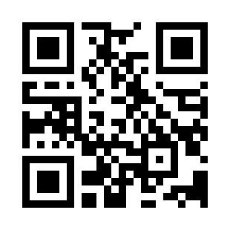


HTML Tags Quiz
https://bit.ly/3VXGg16

